Slide 1

ESC FINAL PROJECT
Bankruptcy Classification
5조
김윤전 | 김내히 | 정재은 | 엄상준 | 홍익선

Slide 2
TABLE
1
EDA Review
2
Modeling
3
Evaluation
4
Prediction
5
Conclusion

Slide 3

EDA REVIEW

Slide 4
1. EDA REVIEW
변수 제거
Correlation Plot 다시 확인
MODELING
DATA
Financial Statements
&
Bankrupt
NA Imputation
Factor Analysis
Outlier 제거

Slide 5
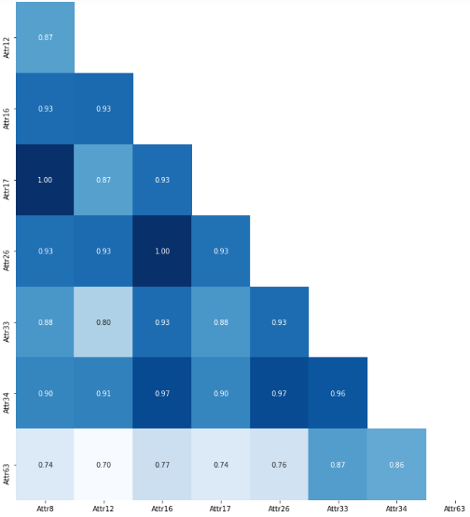
1. EDA REVIEW
0.7
제거 기준
Correlation Plot에서 변수 제거 기준은 0.7
변수 유지 기준
Target 변수와의 상관성
변수 감소
19▼
총 변수 개수
31
Correlation Plot 일부분

Slide 6

Modeling

Slide 7
2. Modeling
Feature Selection
FA를 하지 않고 Feature Importance 등을 확인하여 변수 선택
Feature Extraction
FA를 하여 새로운 변수를 만들어서 Modeling
Notes:
두 가지 방법 모두 사용했다는 의미.

Slide 8
2. Modeling
Feature Selection
FA를 하지 않고 Feature Importance 등을 확인하여 변수 선택
Too Bad..
Feature Extraction
FA를 하여 새로운 변수를 만들어서 Modeling
Notes:
두 가지 방법 모두 사용했다는 의미.

Slide 9
2. Modeling Training
Logistic Regression
Support Vector Machine
Linear & Kernel
01
02
Random Forest
XGBoost
03
04

Slide 10



2. Modeling Training
Training Set
80%
Hyper Parameter Tuning
GridSearchCV
Balanced Weight
데이터 불균형 해소
F1 Score
Cross Validation Score
Check
F1 Score 값은 후에 Ensemble에서 가중치에 반영

Slide 11
2. Modeling Training
Logistic Regression
Positive
Attr48 EBITDA (profit on operating activities - depreciation) / total assets
Attr49 EBITDA (profit on operating activities - depreciation) / sales
Attr40 (current assets - inventory - receivables) / short-term liabilities
Attr36 total sales / total assets
Attr21 sales (n) / sales (n-1)
Positive Coefficients
Negative Coefficients
Negative
Attr23 net profit / sales
Attr4 current assets / short-term liabilities
Attr56 (sales - cost of products sold) / sales
Attr18 gross profit / total assets
Attr50 current assets / total liabilities

Slide 12
2. Modeling Training
Random Forest
Features
0.03
Attr24
0.113
Attr24 gross profit (in 3 years) / total assets
Attr27 profit on operating activities / financial expenses
Attr35 profit on sales / total assets
Attr38 constant capital / total assets
Attr12 gross profit / short-term liabilities
Attr21 sales (n) / sales (n-1)
Attr23 net profit / sales
Attr18 gross profit / total assets
Attr29 logarithm of total assets
Attr51 short-term liabilities / total assets
Feature
Importances
Attr27
0.078
Attr35
0.068
Attr38
0.054
Attr12
0.052
Attr21
0.044
Attr23
0.041
Attr18
0.039
Attr29
0.037
Attr51
0.036

Slide 13



2. Modeling Training
Random Forest
Profitability
Stability
ETC
X24 gross profit(in 3 years) / total assets
X27 profit on operating activities / financial expenses
X35 profit on sales / total assets
X23 net profit / sales
X18 gross profit / total assets
X38 constant captial / total assets
X12 gross Profit / Short-term liabilites
X51 short-term liabilities / total assets
X21 sales (n) / sales(n-1)
X29 logarithm of total assets

Slide 14
2. Modeling Training
XGBoost
Features
0.03
Attr21
0.070
Attr21 sales (n) / sales (n-1)
Attr24 gross profit (in 3 years) / total assets
Attr27 profit on operating activities / financial expenses
Attr35 profit on sales / total assets
Attr58 total costs /total sales
Attr12 gross profit / short-term liabilities
Attr36 total sales / total assets
Attr9 sales / total assets
Attr18 gross profit / total assets
Attr23 net profit / sales
Feature
Importances
Attr24
0.063
Attr27
0.056
Attr35
0.055
Attr58
0.052
Attr12
0.052
Attr36
0.048
Attr9
0.046
Attr18
0.043
Attr23
0.039

Slide 15
2. Modeling Training
XGBoost
Profitability
Stability
ETC
X24 gross profit(in 3 years) / total assets
X27 profit on operating activities / financial expenses
X35 profit on sales / total assets
X58 total costs / total sales
X23 net profit / sales
X36 total sales / total assets
X9 sales / total assets
X18 gross profit / total assets
X12 Gross Profit / Short-term liabilites
X21 Sales (n) / Sales(n-1)

Slide 16
2. Modeling Training
Random Forest & XGBoost
Attr21
Attr38
Attr23
Attr58
Attr24
Random Forest
Attr18
XGBoost
Attr51
Attr27
Attr36
Attr35
Attr29
Attr9
Attr12

Slide 17
2. Modeling selection
Logistic Regression
Support Vector Machine
Linear & Kernel
01
02
0.212
Linear
0.221
Kernel
0.212
Random Forest
XGBoost
03
04
0.200
0.452

Slide 18
2. Modeling selection
Logistic Regression
SVM(Linear)
0.203
0.196
ENSEMBLE
0.185
0.417
XGBoost
Random Forest

Slide 19

Evaluation

Slide 20
3. Evaluation
Train Set
0.571
0.533
XGBOOST
Ensemble
Test Set
0.395
0.188
XGBOOST
Ensemble

Slide 21
3. Evaluation
Train Set
0.571
0.533
XGBOOST
Ensemble
Test Set
0.395
0.188
XGBOOST
Ensemble

Slide 22

Prediction

Slide 23



4. Prediction
Test Data Set
- 2937개
- NA Imputation 필요 → Median
Threshold 조정 전
- 전부 0으로 처리.
XGBoost
Threshold 조정 후
- Test f1 score: 0.48로 상승
- 0: 2782 1: 155

Slide 24

Conclusion

Slide 25




5. Conclusion
Bagging: Random Forest
Boosting: XGBoost
Ensemble: Logistic + Random Forest + SVM + XGB
Models
Random Forest: 우리의 데이터가 Linear하게 분류하기 힘듦
SVM, Logistic: 마찬가지로 선형적으로 분류하기 힘든 데이터
Bad Models
Conclusion
XGBoost: 오분류 케이스 → Modeling 반복 → Flexible
Ensemble: Training된 모델의 예측치의 평균 → 과적합 해소
다른 Dataset: Dataset에 따라 좋은 모델이 다름
Better Models
SMOTE: Data Generalizing → 형편없는 성능
→ 가중치 반영이 낫다.
Data Balance

Slide 26
5. Conclusion
이번 학기 모두 수고 많으셨습니다.

Slide 27

Thank You

